Slide 1


Gift Application
Thuy-Linh Nguyen & Hajra Intikhab

Slide 2
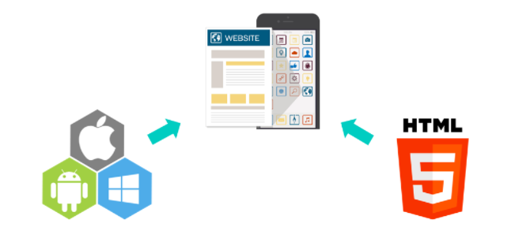
What is it?
Many people struggle finding the perfect gift for their family, friends, or collegues.
We made an app that allows you to choose between categories and then it picks out a few gift ideas.
It also tells you the price of the
items.

Slide 3
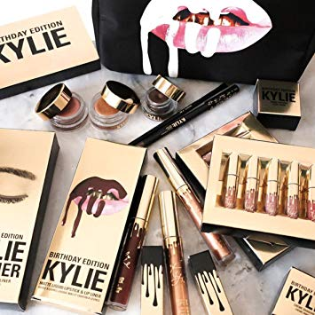


Categories [Inputs]
The app has three different categories to choose from:
Technology
Home Decor
Make-up

Slide 4
The Gifts [Outputs]
The output will be a list of 3 items in that category one under each price range:
$10 and under [$1-$10]
$50 and under [$11-$50]
$100 and under [$51-$100]

Slide 5
Functionalities
The application will need to use if statements for the price of the gift and be able to reference various items when given a category.
Different categories and prices will be in an array.

